Slide 1
REGISTRATION FORM
PREPARED BY
A.CHARITHA
H.BHARGAVI
T.NAGAJYOTHI

Slide 2
ABSTRACT
A submission form will become accessible after your granting authorization to process your data (see the first step of the form). This formality is required by the Italian Law on privacy (Italian decree no. 196 of 30 June 2003).

Slide 3
PROCEDURE
Registration and abstract submission deadline: march 31, 2016
You are kindly requested to submit and abstract about your current work
Abstracts must be submitted in English
Only online submission are accepted. Authors will be required to register with the site to create a user profile. After creating a profile, an author can submit and modify an abstract until the registration deadline

Slide 4
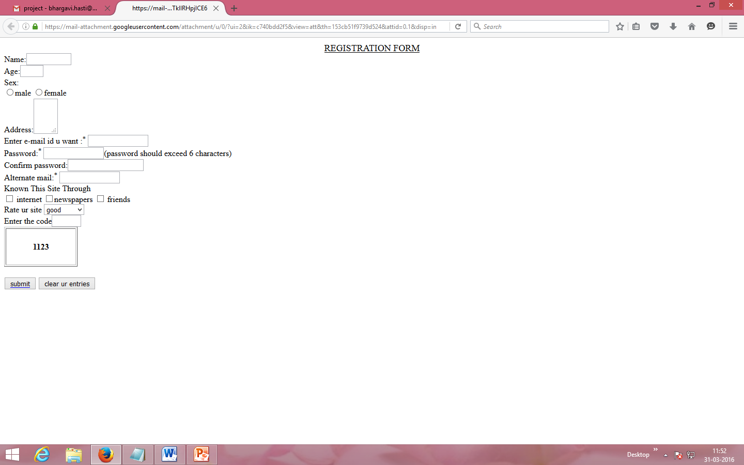
OUTPUT:

Slide 5
THANK YOU

